Slide 1
Opti ID
Graham Carr | 31st May 2024
Notes:
These are notes

Slide 2

About me
Graham Carr
Lead .Net Developer
Email: graham.carr@26-dx.com
LinkedIn: https://www.linkedin.com/in/carrgraham/
Blog: https://world.optimizely.com/blogs/allthingsopti/

Slide 3
Agenda
01
What is Opti ID
02
How to enable Opti ID
03
Configure SSO with SAML or OIDC
04
Other features
05
Demonstration
06
Questions
Agenda

Slide 4
What is Opti ID

Slide 5



So, what’s the big deal?!?!
Notes:
Optimizely has acquired many products over the last few years
All have different logins making the product suite feel disparate
Opti ID is a great solution for organisations who have multiple Optimizely products that they want to be able to access via an integrated SSO solution.

Slide 6
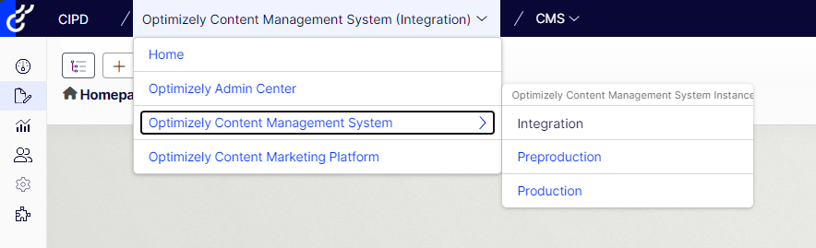
One login, most products
Opti ID provides a centralised login experience, allowing you to switch between Optimizely products with just one authentication
Centralised Login With SSO
Okta, Azure Entra, Local Login
Application Switching
No need to re-authenticate
User Administration
Easily manage Opti Id users, groups and roles
Account and User Dashboard
View usage and billing information

Slide 7
10/9 Key Points
Customized Commerce
Configured Commerce
Content Management System (CMS12)
Content Marketing Platform (CMP)
Digital Experience Platform (DXP)
Experimentation
Experiment Collaboration
Optimizely Data Platform (ODP)

Slide 8
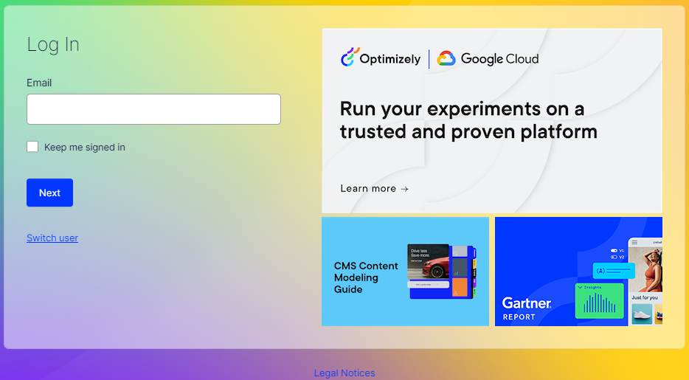
Login Screen
Goodbye to the old login
https://<sitename>/episerver/cms
Hello to two new ways to login
https://login.optimizely.com
https://<sitename>/ui/cms
Both redirect to the Opti ID login screen

Slide 9
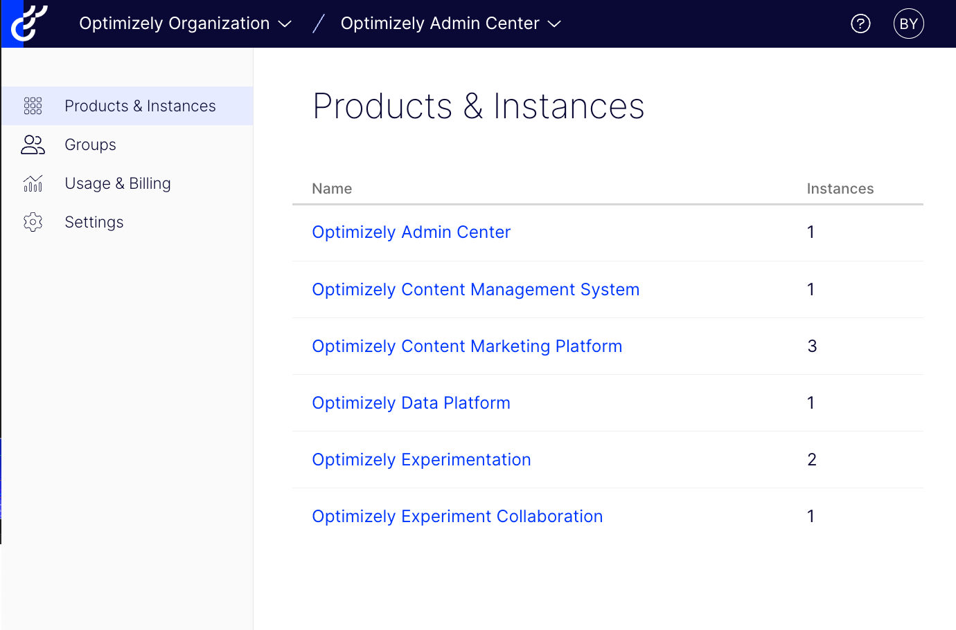
Optimizely Admin Center
One stop shop for accessing:
Products and instances
Users, groups and roles
Usage and Billing
Settings
SSO
Domains / Dynamic Provisioning
MFA

Slide 10
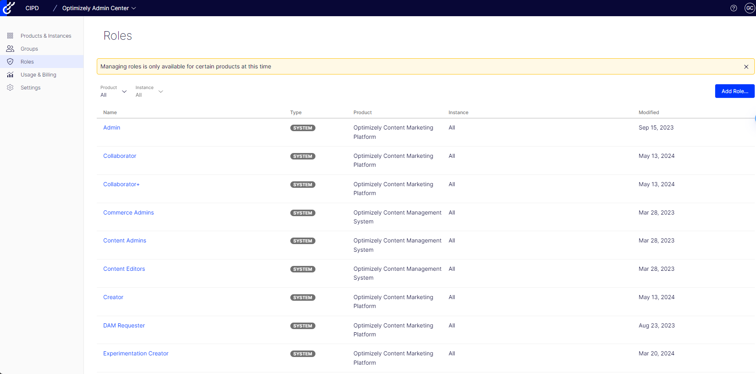
User Administration
Users
Part of SSO or local login
Can be invited via admin center
Groups
Can contain one or more roles
Can contain one or more products
Roles
Define level of permission
Product
Environment

Slide 11
How to enable Opti ID

Slide 12
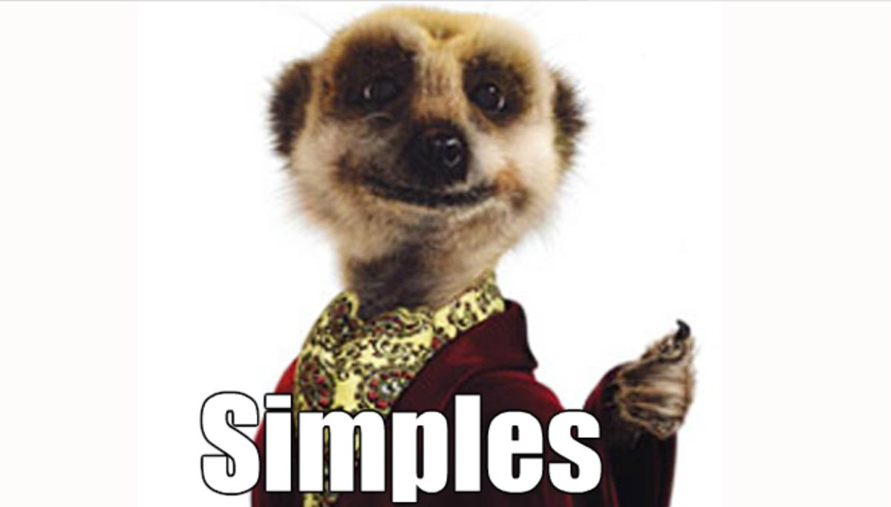
Enabling Opti ID
Install Nuget Package
In Startup.cs in the Configure Services method:
Remove any code references to ASP.Net Identity:
IMPORTANT!!
Remove mapping of CmsEditor and CmsAdmin in appsettings.json!!
Opti ID automatically maps these virtual roles for you….

Slide 13
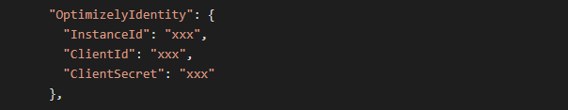
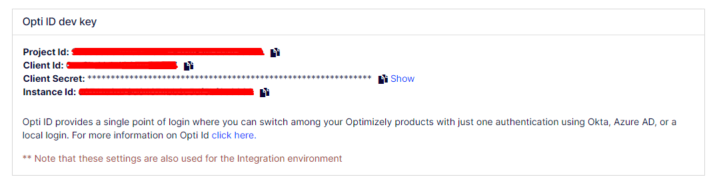
Enabling Opti ID for local development
Opti ID can be run locally on your development environment, simply add the following to your appsettings.json file
(Note: these values get added automatically when you deploy your website to DXP)
To get values for these, head over to PaaSPortal (https://paasportal.episerver.net) Click on the API tab and you will see the settings

Slide 14
Configure SSO with SAML or OIDC

Slide 15
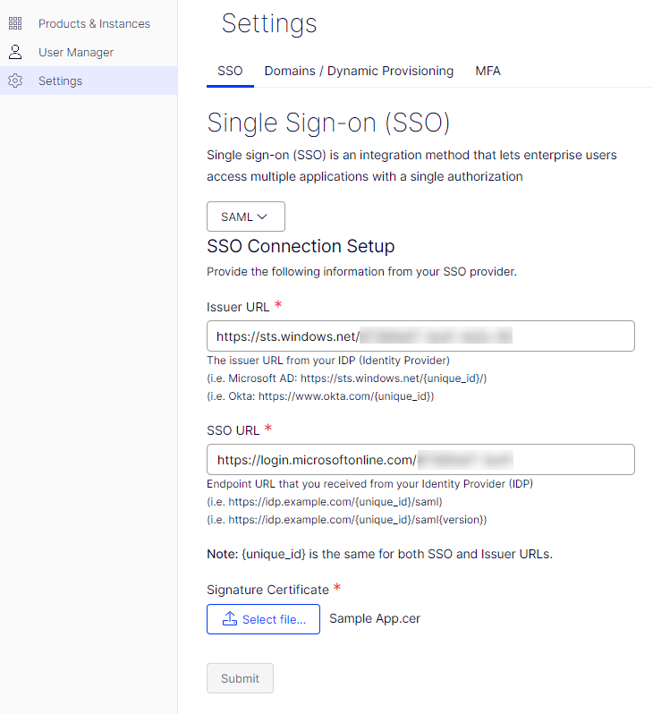
SAML (Security Assertion Markup Language)
Open standard used for authentication
Using XML format, web applications use SAML to transfer authentication data between two parties
Older standard, hard to use for authenticating modern application types such as SPAs and smartphone apps
SAML been around much longer, so still trusted by a lot of organisations, especially government entities
Feature rich but OIDC now starting to catch up
https://support.optimizely.com/hc/en-us/articles/18129917620109-Configure-SSO-with-Opti-ID-using-SAML

Slide 16
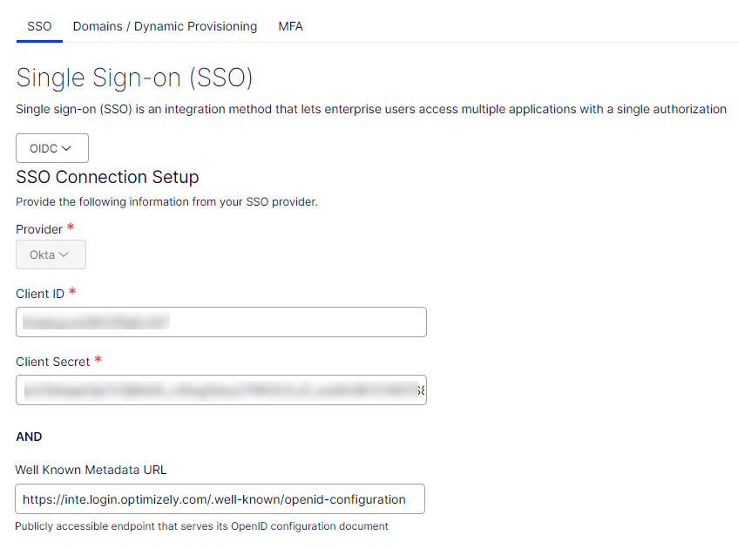
OIDC (Open ID Connect)
Relatively newer and well-maintained protocol
Built on top of the OAuth 2.0 framework
Uses JSON-based web token to structure data
JWT is an industry standard
OIDC is much easier to setup
OIDC uses default HTTPS flows
OIDC supports user consent by default https://support.optimizely.com/hc/en-us/articles/18129890210573-Configure-SSO-with-Opti-ID-using-OIDC

Slide 17
Other features

Slide 18
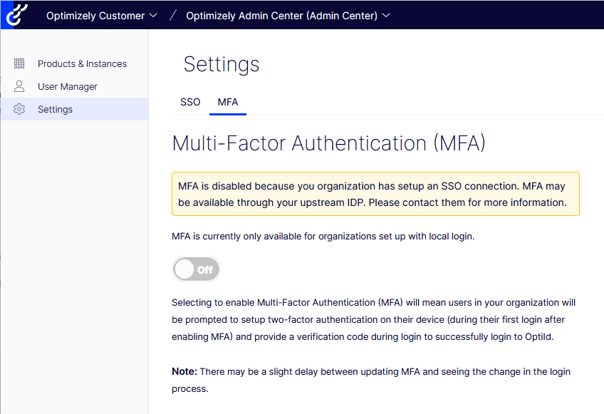
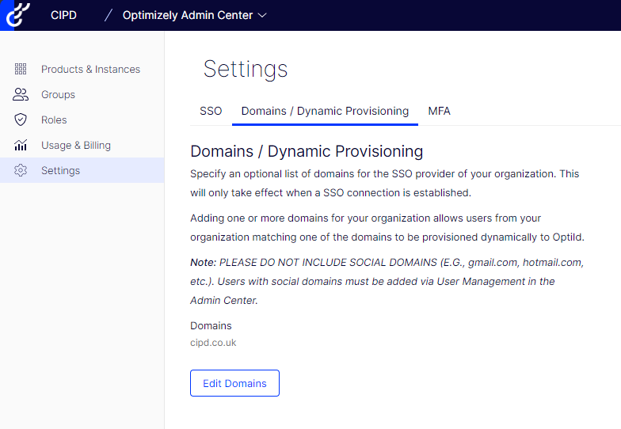
Other features
Multi-factor Authentication (Local Login only)
Domains / Dynamic Provisioning

Slide 19

Coming Soon!!
Feature-based trials and self-service reporting!!

Slide 20
Demonstration

Slide 21
Resources
https://support.optimizely.com/hc/en-us/categories/25425385971469-Opti-ID https://support.optimizely.com/hc/en-us/articles/12613241464461-Get-started-with-Opti-ID https://docs.developers.optimizely.com/platform-optimizely/v1.2.0-opti-id/reference/authentication https://support.optimizely.com/hc/en-us/sections/22954800495885-Release-notes

Slide 22
Questions?

Slide 23
Thank you
Graham Carr
graham.carr@26-dx.com

